Slide 1
Lecture No. 3 Electrochemistry
At the end of this lecture, students will be able to:
Explain the construction of a concentration cell
Describe the construction, working and limitations of SHE
Discuss the construction and working of calomel and Ag-AgCl electrodes

Slide 2
Concentration Cell
Concentration cell is a Galvanic cell that has two identical half-cells of the same material differing only in concentrations
Potential arises due to a decrease in free energy due to difference of concentration (activity) between the two electrodes
Cell potential can be calculated using the Nernst Equation
Concentration cell produces a voltage as it attempts to reach equilibrium, which will occur when the concentration in both cells are not equal

Slide 3
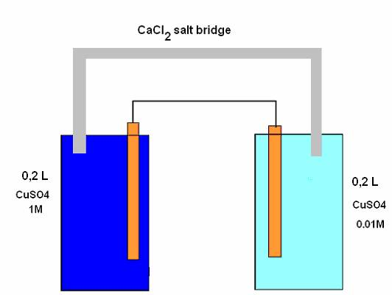
Concentration Cell
Electrolyte Concentration Cells consist of two electrodes of the same substance in contact with solutions of different concentrations
Potential difference arises as long as concentration difference exists
Anode Cathode
Cu⎥ CuSO₄ (0.01M)⎥ ⎥ CuSO₄(1M)⎥ Ag
C1 C2
c₂ > c₁

Slide 4
Concentration Cell
Anodic reaction: Cu → Cu²⁺ (c₁) + 2e
Cathodic reaction: Cu²⁺ (c₂) + 2e → Cu
Cell reaction: Cu²⁺ (c₂) → Cu²⁺ (c₁)
Cell potential is given by E_{cell} = E_{cathode} – E_{anode}

Slide 5
Concentration Cell
For spontaneous cell reaction, c₂ > c₁,
More concentrated solution containing half cell act as cathode and is placed right to the salt bridge (cathode half cell)
Less concentrated solution containing half cell act as anode and is placed left to the salt bridge (anode half cell)
Electrode Concentration Cells consist of two electrodes of different concentrations and a common electrolyte solution

Slide 6
Concentration Cell
Using amalgams or gas electrodes, electrode concentration can be altered
For a gas concentration cell,
Pt ⎥ H₂ (P₁) ⎥ HCl⎥ H₂ (P₂) ⎥ Ag
P₁ > P₂
Cell reaction: H₂ (P₁) → H₂ (P₂)
Cell potential: E_{cell} = (RT/nF) ln (P₁ / P₂) P₁ > P₂

Slide 7
Concentration Cell
Electrode concentration cells are also constructed with amalgams
Electrodes are preferred particularly when the electrode material is a highly reactive metal, such as Li, Na, K, etc which reacts with aqueous solution
Reactivity of the metal is decreased by converting the metal into amalgam
Na-Hg (c₁) ⎥ Na⁺⎥ Na-Hg (c₂) c₂ > c₁
Cell reaction: Na-Hg (c₁) → Na-Hg (c₂)
Cell potential: c₂ > c₁

Slide 8
Applications of Concentration Cell
Concentration cell methods form the method of chemical analysis to compare a solution of known concentration with an unknown
Determining the concentration of the unknown via the Nernst Equation or comparison tables against a group of standards

Slide 9
Reference Electrodes
Reference electrodes are the electrodes of known constant electrode potential with reference to which the electrode potential of any other electrode can be measured
Classification: 1. Primary reference electrode – SHE
2. Secondary Reference Electrode – Calomel, Ag-AgCl

Slide 10
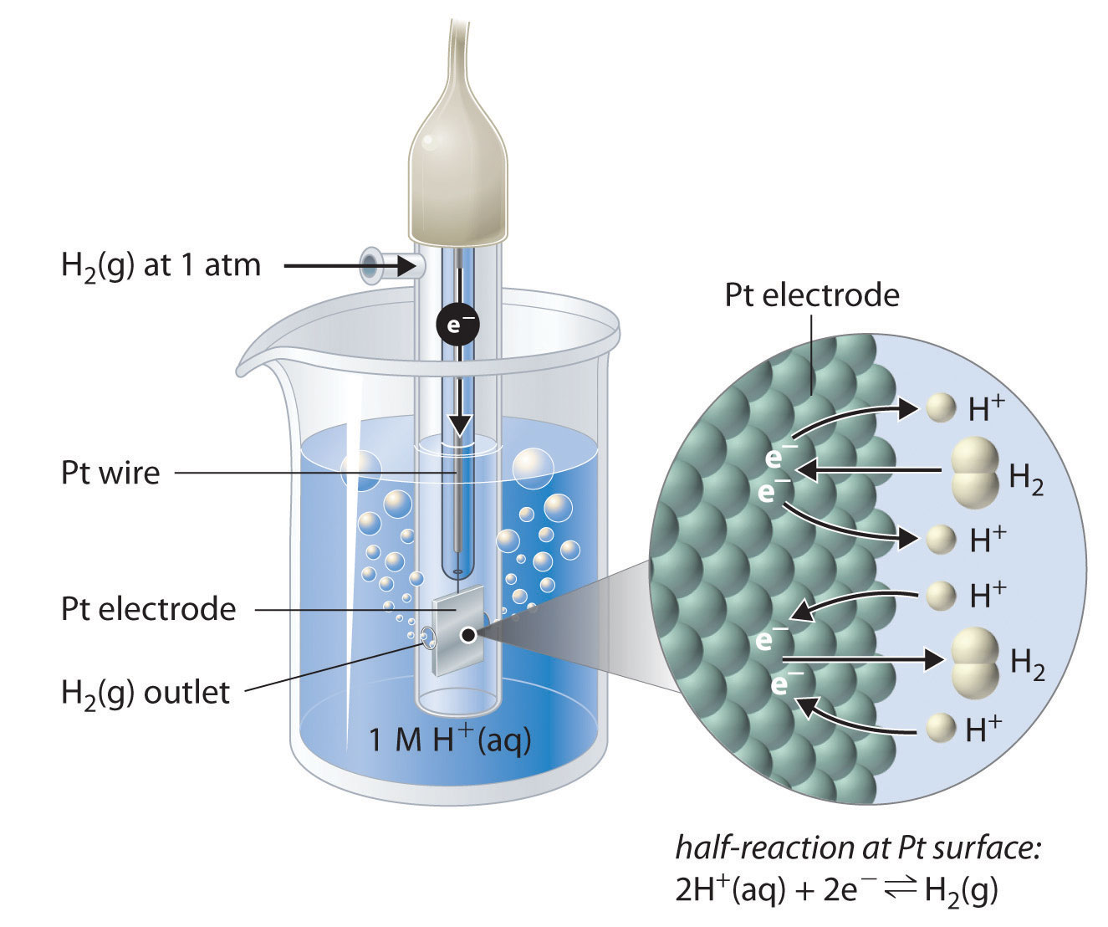

Construction of Standard Hydrogen Electrode
SHE is a primary reference electrode – It is a redox electrode which forms the basis of the thermodynamic scale of oxidation-reduction potentials, its potential is taken as zero at all temperature
2H⁺(aq) + 2e⁻ → H₂(g)
Construction of SHE:
platinized platinum electrode
hydrogen gas is passed at 1 atm
solution of the acid with activity of H⁺ = 1 mol dm⁻³

Slide 11
Construction of Standard Hydrogen Electrode
Redox reaction occurs at a platinized platinum electrode and the electrode is dipped in an acidic solution with pure hydrogen gas bubbled through it
Concentration of both the reduced form and oxidised form is maintained at unity
Pressure of hydrogen gas is 1 atm and the activity of hydrogen ions in the solution is unity
Activity of hydrogen ions is their effective concentration, which is equal to the formal concentration times the activity coefficient
Unit-less activity coefficients are close to 1.00 for very dilute water solutions, but are usually lower for more concentrated solutions

Slide 12


Construction of Standard Hydrogen Electrode
Nernst equation should be written as:
or
where:
a_{H+} is the activity of the hydrogen ions, a_{H}⁺ = f_{H}⁺ C_{H}⁺ /C⁰
p_{H2} is the partial pressure of the hydrogen gas, in pascals, Pa
R is the universal gas constant
T is the temperature, in Kelvin
F is the Faraday constant (the charge per mole of electrons), equal to 96485.34 C mol⁻¹
p⁰ is the standard pressure 10⁵ in Pa

Slide 13
Construction of Standard Hydrogen Electrode
Choice of platinum for the hydrogen electrode is due to several factors:
Inertness of platinum, catalyze the reaction of proton reduction, a high intrinsic exchange current density for proton reduction on platinum
Excellent reproducibility of the potential
Surface of platinum is platinized (i.e., covered with platinum black) to: increase total surface area, which improves reaction kinetics and maximum possible current
Other metals can be used for building electrodes with a similar function such as the palladium-hydrogen electrode

Slide 14
Standard Hydrogen Electrode
Disadvantages:
Very difficult to set up the electrode
Electrode becomes inactive in presence of impurity present in hydrogen gas
Electrode cannot be used in presence of redox species
Pure and expensive hydrogen gas is required and should be maintained at 1 atm
Factors limiting its applications:
Organic substances and oxygen interference needs to be avoided (may get adsorbed onto Pt)

Slide 15
Standard Hydrogen Electrode
Inorganic ions that can reduce to a lower valency state at the electrode also have to be avoided (e.g., Fe³⁺, CrO₄²⁻)
Many organic substances are also reduced by hydrogen at a platinum surface, and these also have to be avoided
Cations that can reduce and deposit on the platinum can be source of interference: silver, mercury, copper, lead, cadmium and thallium
Substances that can inactivate ("poison") the catalytic sites include arsenic, sulfides and other sulfur compounds, colloidal substances, alkaloids, and material found in living systems – needs to be avoided

Slide 16
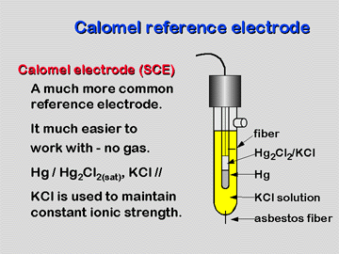
Secondary Reference Electrodes – Construction & Working of Calomel Electrode
The electrode is represented as
The half cell reaction is ½ Hg₂Cl₂ + e  Hg + Cl⁻

Slide 17
Working of Calomel Electrode
Forward reaction is a reduction reaction and the backward reaction is an oxidation reaction
Hence, calomel electrode can act as both anode and cathode depending on the nature of other electrode coupled
As calomel electrode is reversible w.r.t Cl⁻ ions the potential of the electrode depends on the concentration of KCl used
Where n = 1 for H⁺ ions
Saturated KCl; E_{calomel} = 0.2422V
1M KCl; E_{calomel} = 0.280 V
1M KCl; E_{calomel} = 0.334 V

Slide 18
Calomel Electrode
Advantages: It is simple to construct, Electrode potential is reproducible and variation with temperature is negligibly small
Applications: The SCE is used in pH measurement, cyclic voltammetry and general aqueous electrochemistry
SCE and the silver/silver chloride reference electrode work in the same way
In both electrodes, the activity of the metal ion is fixed by the solubility of the metal salt
Calomel electrode contains mercury, which poses much greater health hazards than the silver metal used in the Ag/AgCl electrode

Slide 19
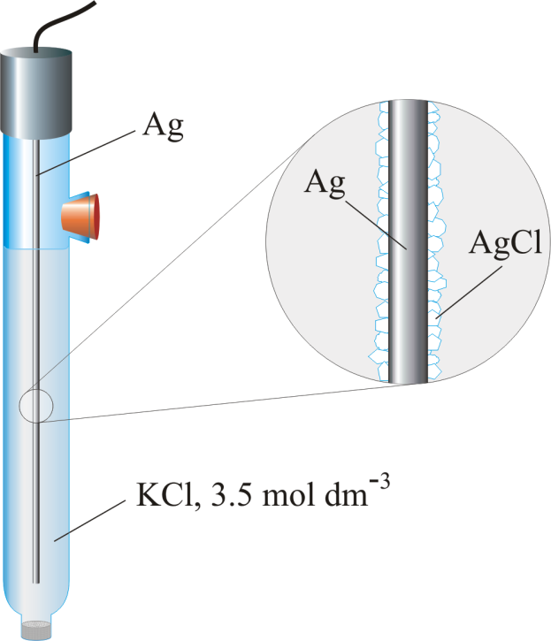
Construction & Working of Ag-AgCl Electrode
Construction:
Coating a thin layer of Ag on Pt wire by electrolysis in AgCN (argentocyanide) solution
Silver is then partly converted into AgCl by making it an anode in KCl solution and passing a low current density for 30 minutes
The half cell reaction is
Where n = 1 for Ag⁺ ions

Slide 20
Working of Ag-AgCl Electrode
Ag/AgCl electrode can act as both anode and cathode depending on the nature of other electrode coupled
Ag/AgCl electrode is reversible w.r.t. Cl⁻ ions - the potential of the electrode depends on the concentration of KCl used
Electrode | Potential
 | (V) at 25 °C
Ag/AgCl/Sat. KCl | +0.197
Ag/AgCl/3.5 mol/kg KCl | +0.205
Ag/AgCl/3.0 mol/kg KCl | +0.210
Ag/AgCl/1.0 mol/kg KCl | +0.235
Ag/AgCl/0.6 mol/kg KCl | +0.25
Ag/AgCl (Seawater) | +0.266
Ag/AgCl / 0.1M KCl | +0.2901

Slide 21
Advantages of Ag-AgCl Electrode
Temp °C | Potential E^{0,} V
25 | 0.22233
60 | 0.1968
125 | 0.1330
150 | 0.1032
175 | 0.0708
200 | 0.0348
225 | -0.0051
250 | -0.054
275 | -0.090
Simple to construct
Inexpensive to manufacture
Stable potential
Non-toxic components
can be used up to 300 °C

Slide 22
Applications of Ag-AgCl Electrode
Used as reference electrode to determine the uniformity of potential in ship hulls and pipe lines protected by anodic protection against corrosion
Used as reference electrode for submerged oil pipelines, can operate upto a depth of 300 meters and measures the potential to a precision of ±1 mv
Used as internal reference electrode with ion-selective electrodes

Slide 23
Summary
Construction of concentration cell
Eg: Zn |Zn2+ c1||Zn2+ c2|Zn
Construction and working of SHE,
Calomel:
Ag-AgCl electrode
Ag |AgCl |KCl (sat)

